Slide 1
Lipids: Fatty Acids and Triacylglycerols

Slide 2
Quiz Question #1
How does peroxisomal lipid oxidation differ from mitochondrial lipid oxidation?
Different terminal electron acceptor
Different rate limiting enzyme
Different substrate preferences
All of the above

Slide 3
Quiz Question #2
What does not promote ketogenesis?
Lack of carbohydrates
Prolonged fasting
Reduced lipolysis in adipose tissue
Uncontrolled Type 1 Diabetes

Slide 4
Quiz Question #3
What is a clinical presentation of MCAD deficiency (MCAD is a β-oxidation enzyme) after fasting or stress?
Hypoketosis and Hyperglycemia
Hypoketosis and Hypoglycemia
Ketosis and Hypoglycemia
Ketosis and Hyperglycemia

Slide 5
Learning Objectives
Understand how fatty acids are synthesized in the body
Describe the initial highly regulated step of FA synthesis
Understand the reactions resulting in triacylglycerol synthesis resulting in 3 fatty acids esterified to glycerol
Describe the breakdown of triacylglycerol to glycerol plus fatty acids and the fates of these products
Describe fatty acid breakdown (beta-oxidation)
Determine the amount of energy produced by fatty acid breakdown in comparison to glucose
Understand when ketogenesis occurs, what organs ketones are a fuel source for and consequences of overactive ketogenesis

Slide 6
Overview of Lipid Metabolism
Fatty Acid Metabolism
Obtaining Fatty Acids from Diet
Making Fatty Acids de novo
Oxidizing Fatty Acids
Triglyceride Metabolism
Synthesizing new triglycerides
Mobilizing Fatty Acids from Triglycerides
Cholesterol Metabolism
Cholesterol Synthesis
Cholesterol Excretion (Bile Salts)

Slide 7
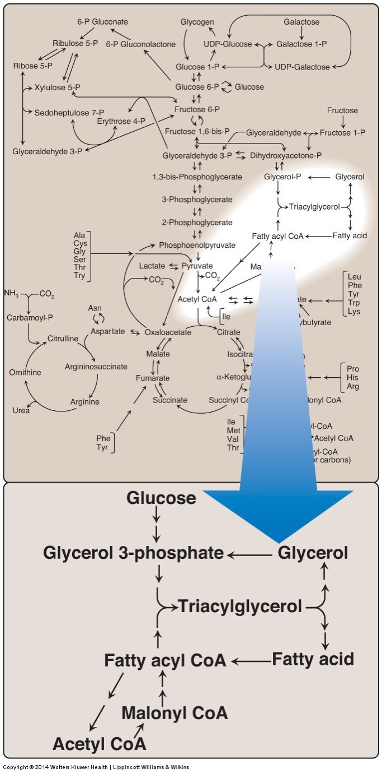
Synthesis of Fatty Acids
Two sources of fatty acids
Dietary
Synthesis from precursors (de novo)
Main sites of biosynthesis: liver and adipose tissue

Slide 8
Starts with Acetyl CoA
What are sources of acetyl CoA?
Notes:
Ketogenic Amino Acids
Pyruvate Dehydrogenase
Ketone Bodies

Slide 9
Key Regulatory Steps
ATP Citrate Lyase
Acetyl CoA Carboxylase
Fatty Acid Synthase

Slide 10
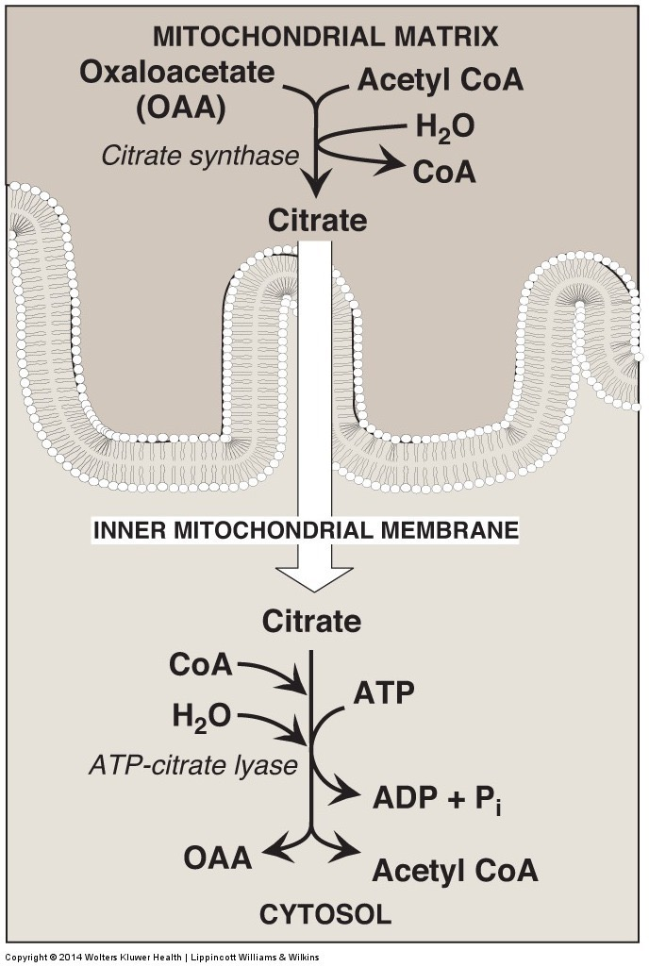
ATP – Citrate Lyase
The problem:
Acetyl CoA is needed for Fatty Acid Biosynthesis in the cytoplasm
Acetyl CoA from PDH/AA Catabolism is in the mitochondria
No AcetylCoA transporters
The solution
Citrate is made (see TCA for regulation)
Citrate is transported out, reconverted back to Acetyl CoA by ATP Citrate Lyase

Slide 11
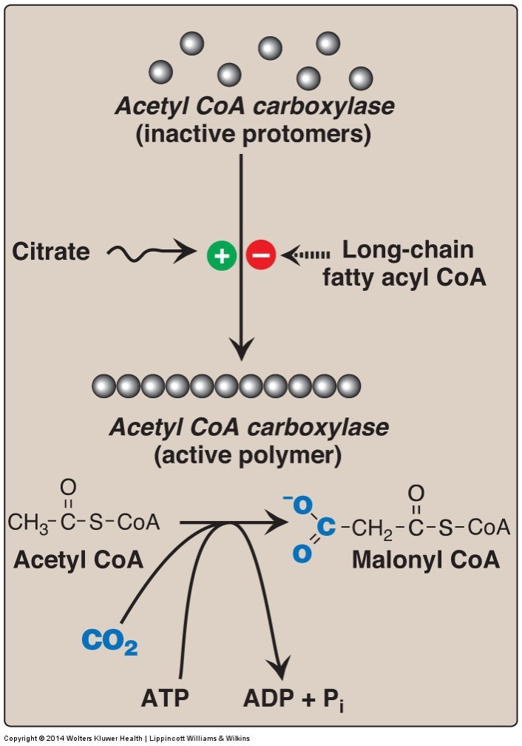
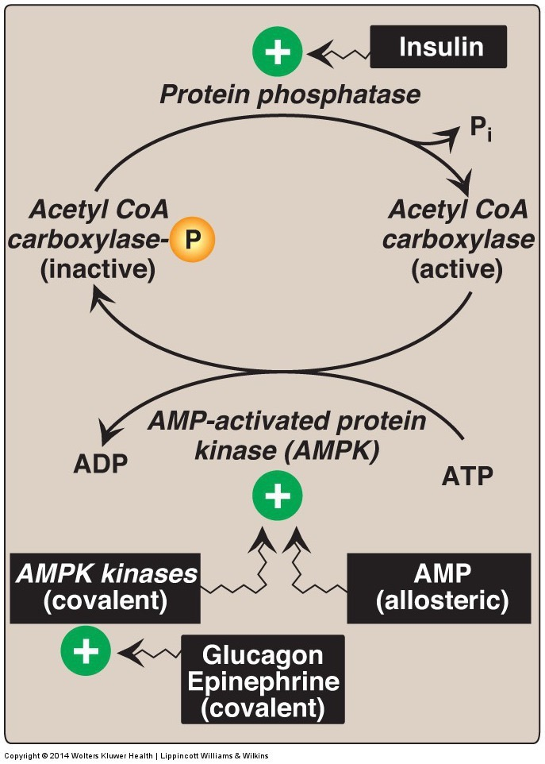
Acetyl CoA Carboxylase
Regulated Allosterically
Inactivated by AMPK
Notes:
So low energy can prevent fatty acid synthesis

Slide 12
Malonyl CoA Controls the Balance Between FA Synthesis and Degradation
Serves as a substrate for FA synthesis
Prevents re-import of fatty acids into mitochondria
CPT1 is a fatty acid transporter in mitochondria
Therefore Malonyl CoA prevents beta oxidation

Slide 13
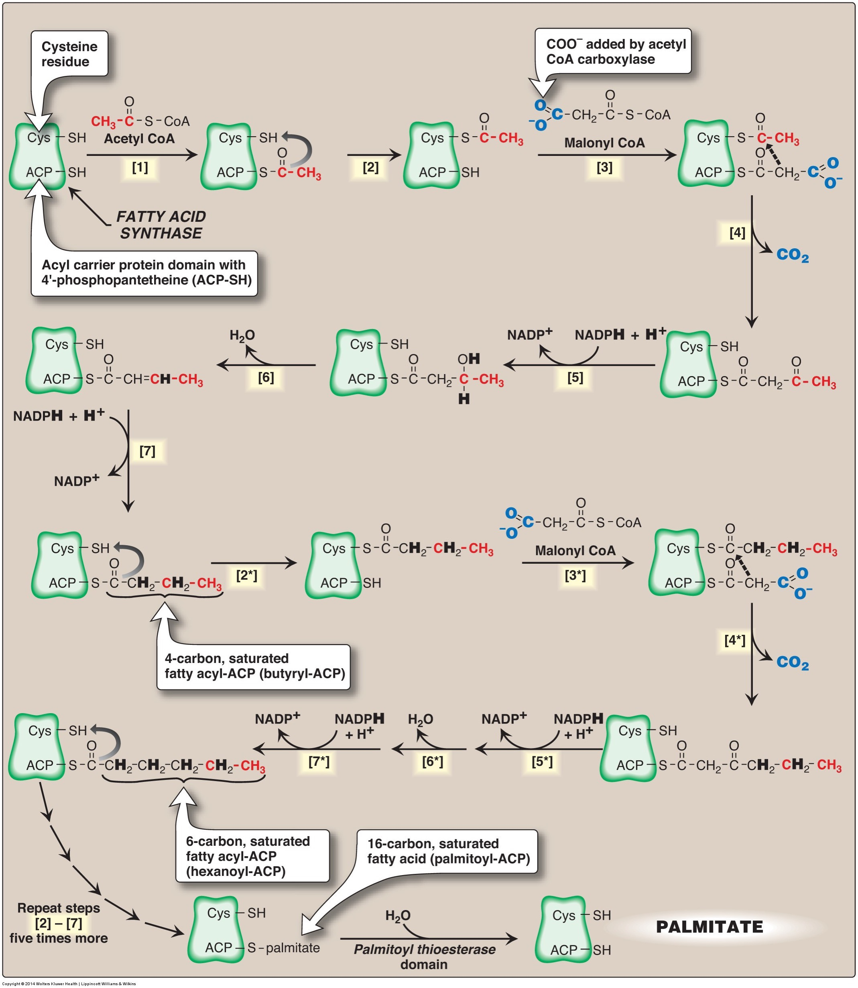
The Rest of Fatty Acid Synthesis is Mediated by Fatty Acid Synthase
Reaction including ACC:
Consumes:
14 Malonyl CoA
7 Acetyl CoA (total of 21)
14 ATP (to make Malonyl CoA)
14 NADPH
Makes 1 Palmitate
Notes:
Plus some other waste products like CO2, ADP, NADP

Slide 14
Where does NADPH come from?
Glycolysis
TCA Cycle
Ketogenesis
Pentose Phosphate Shunt

Slide 15
Fatty Acid Biosynthesis Accounting
How many glucose units?
2 NADPH per glucose in PPS

Slide 16
Transcriptional Control of FA Biosynthesis
ACC, ACLY and FAS are transactivated by
SREBP1c
Regulated by insulin/mTORC1
ChREBP
Regulated by high carbohydrates

Slide 17
What happens to palmitate (C16:0)?
Further elongation (e.g. ELOVL6) and Desaturation (e.g. SCD1)
Humans have Δ9,6,5,4 desaturases
VLC PUFAs are generated by sequential desaturation/elongation
But no n-3 or n-3 desaturase activity (see first lipids lecture)
Notes:
Competition between FA species
Elongations are by a factor of 2

Slide 18
Fatty Acid Exercise
Palmitate (C16)
Based on its length, what activity is closest to the methyl group (Δ9,6,5,4)
What ω-type of fatty acid is formed?
Repeat for stearate (C18)
What length fatty acid would we need to have to make a n-6 or n-3 MUFA, why is this unlikely endogenously?
Notes:
n-7, n-9

Slide 19
Under What Conditions is DNL Occurring?
Control
High Glucose Overfeeding
High Sucrose Overfeeding
High Glucose, High Energy
Needs lots of Acetyl-CoA/NADPH/ATP
Contribution to overall lipid balance is due to sparing of fat when carbohydrates are present
Still very important for fatty liver disease
McDevitt RM, Bott SJ, Harding M, Coward WA, Bluck LJ, Prentice AM. De novo lipogenesis during controlled overfeeding with sucrose or glucose in lean and obese women. Am J Clin Nutr 2001; 74:737–46.

Slide 20
Dual Macronutrient Economy Hypothesis
Under Conditions of High Carbohydrates
Preferentially Use Carbohydrates as Fuel
Spare Fat
Prevents beta oxidation
Prevents lipolysis
Causes obesity?
Potentially do to the effects of insulin (this is also known as the insulin:carbohydrate hypothesis)

Slide 21
Lipolysis

Slide 22
Overview of Lipid Metabolism
Fatty Acid Metabolism
Obtaining Fatty Acids from Diet
Making Fatty Acids de novo
Oxidizing Fatty Acids
Triglyceride Metabolism
Synthesizing new triglycerides
Mobilizing Fatty Acids from Triglycerides
Cholesterol Metabolism
Cholesterol Synthesis
Cholesterol Excretion (Bile Salts)

Slide 23
Why Triacylglycerol Breakdown
Stored as triglycerides, used as fatty acids
Brain and RBC can not utilize lipids as energy source
Hydrolysis of triacylglycerol yields: Glycerol and 3 fatty acids
Notes:
\

Slide 24
Triacylglycerol Breakdown
Glycerol
Can be converted to glycolytic intermediates for fuel
Can be phosphorylated to accept new fatty acids but not in adipose
This means adipocytes must make new glycerol for TG esterification
3 fatty acids
Source of energy in fasted states
Fatty acid products enter circulation for other tissues

Slide 25
Regulation of Lipolysis
Promoted by
Restricted by
Glucocorticoids (transcriptional)
Adrenaline (protein phosphorylation)
Insulin (protein dephosphorylation)

Slide 26
Fatty Acid Oxidation

Slide 27
Fatty Acid Oxidation
Fatty acids products– richer source of energy than CHOs
Exist in a more reduced state – undergo greater extent of oxidation
Mechanism of fatty acid oxidation: Beta-oxidation
Occurs in mitochondria of many cell types
Notes:
Remember NADPH

Slide 28
Overview of Lipid Metabolism
Fatty Acid Metabolism
Obtaining Fatty Acids from Diet
Making Fatty Acids de novo
Oxidizing Fatty Acids
Triglyceride Metabolism
Synthesizing new triglycerides
Mobilizing Fatty Acids from Triglycerides
Cholesterol Metabolism
Cholesterol Synthesis
Cholesterol Excretion (Bile Salts)

Slide 29
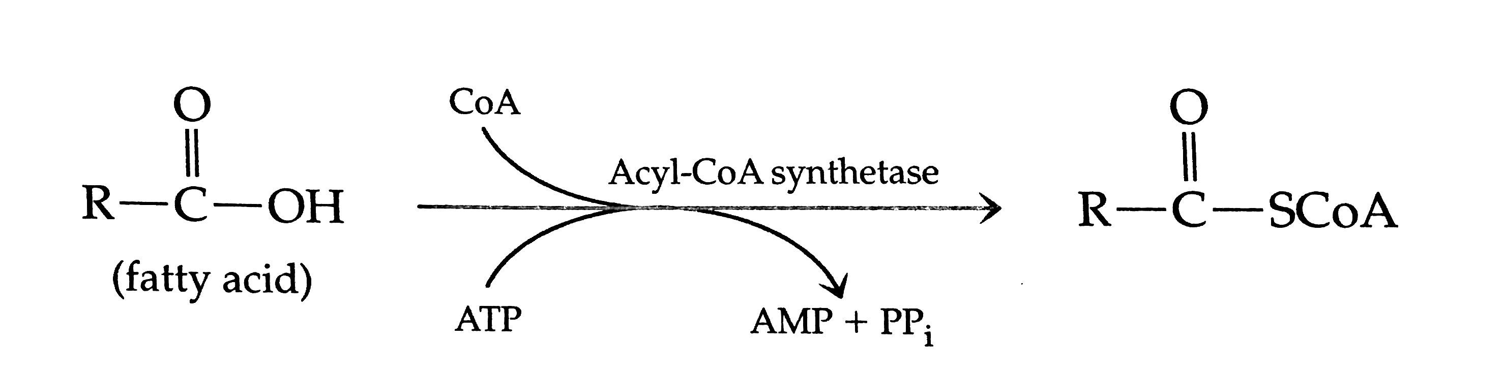
Fatty Acid B-oxidation
Initial reaction converts fatty acid to fatty acid acyl-CoA (cytoplasm) (energy utilization – 2 phosphates)
Fatty acid acyl CoA is transported from the cytoplasm to mitochondria for B-oxidation
Via transport system: Carnitine transport system

Slide 30
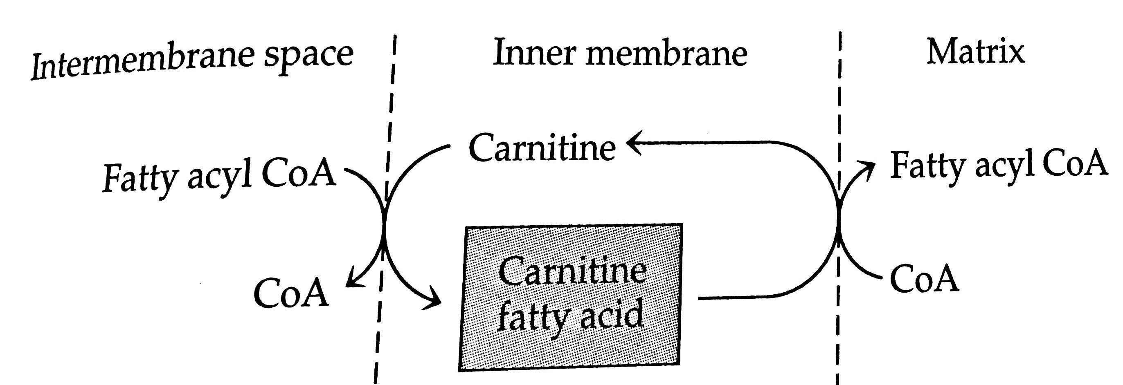
Fatty Acid B-oxidation
Carnitine transport system:
Uses carnitine as a carrier molecule
Carnitine moves fatty acyl CoA from cytoplasm across mitochondrial membrane to mitochondria
Enzymes: Carnitine Palmitoyltransferase 1 (CPT1) and CPT2
CPT1 is negatively modulated by Malonyl CoA
CPT1
Mitochondrial Membrane
Cytosol
Mitochondria
CPT2

Slide 31
Where does carnitine come from?
Lysine
Arginine
Asparagine
Glutamine
Notes:
Lysine

Slide 32
Fatty Acid B-oxidation
Fatty acyl CoA in mitochondria
Acetyl CoAs (2 carbon units) cleaved from the carboxyl ends of FA
Generates NADH and FADH at each step

Slide 33
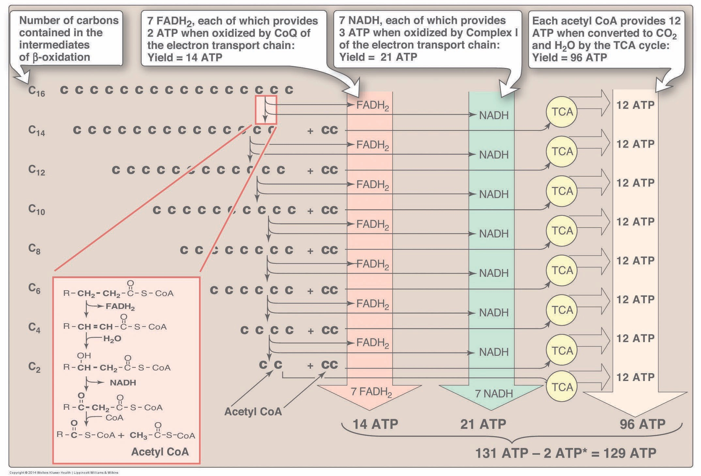
Energy From β-oxidation
Notes:
38 per glucose
The 2 is from the activation to Acyl-CoA

Slide 34
Unsaturated Fatty Acids and Chain Length
In general PUFA/MUFA are oxidized faster
Dehydrogenation step isnt needed
Short/medium chain fatty acids are also oxidized faster
Direct portal transport to liver
SCFA do not need carnitine transport
Very long chain fatty acids in peroxisomes

Slide 35
Peroxisomal Beta Oxidation
Very long chain fatty acids (>22 C) are selectively oxidized in peroxisomes then transferred to mitochondria
Not coupled to ETC
Peroxide generated instead of O2 -> H20 in ETC
Peroxide removed as catalase (no ATP here)
Defects lead to accumulation of VLCFA (Zellweger syndrome)

Slide 36
What are the key steps of regulation?
Lipolysis: providing fatty acids to tissues (muscle)
Adrenaline/Cortisol
Insulin
CPT1 transport
Malonyl CoA elevations signal to shift towards FA biosynthesis
Energy Needs
ADP levels drive ETC, need to clear out NADH/FADH
Notes:
What happens if the fatty acids are oxidized, say in the liver but there is not a need for energy

Slide 37
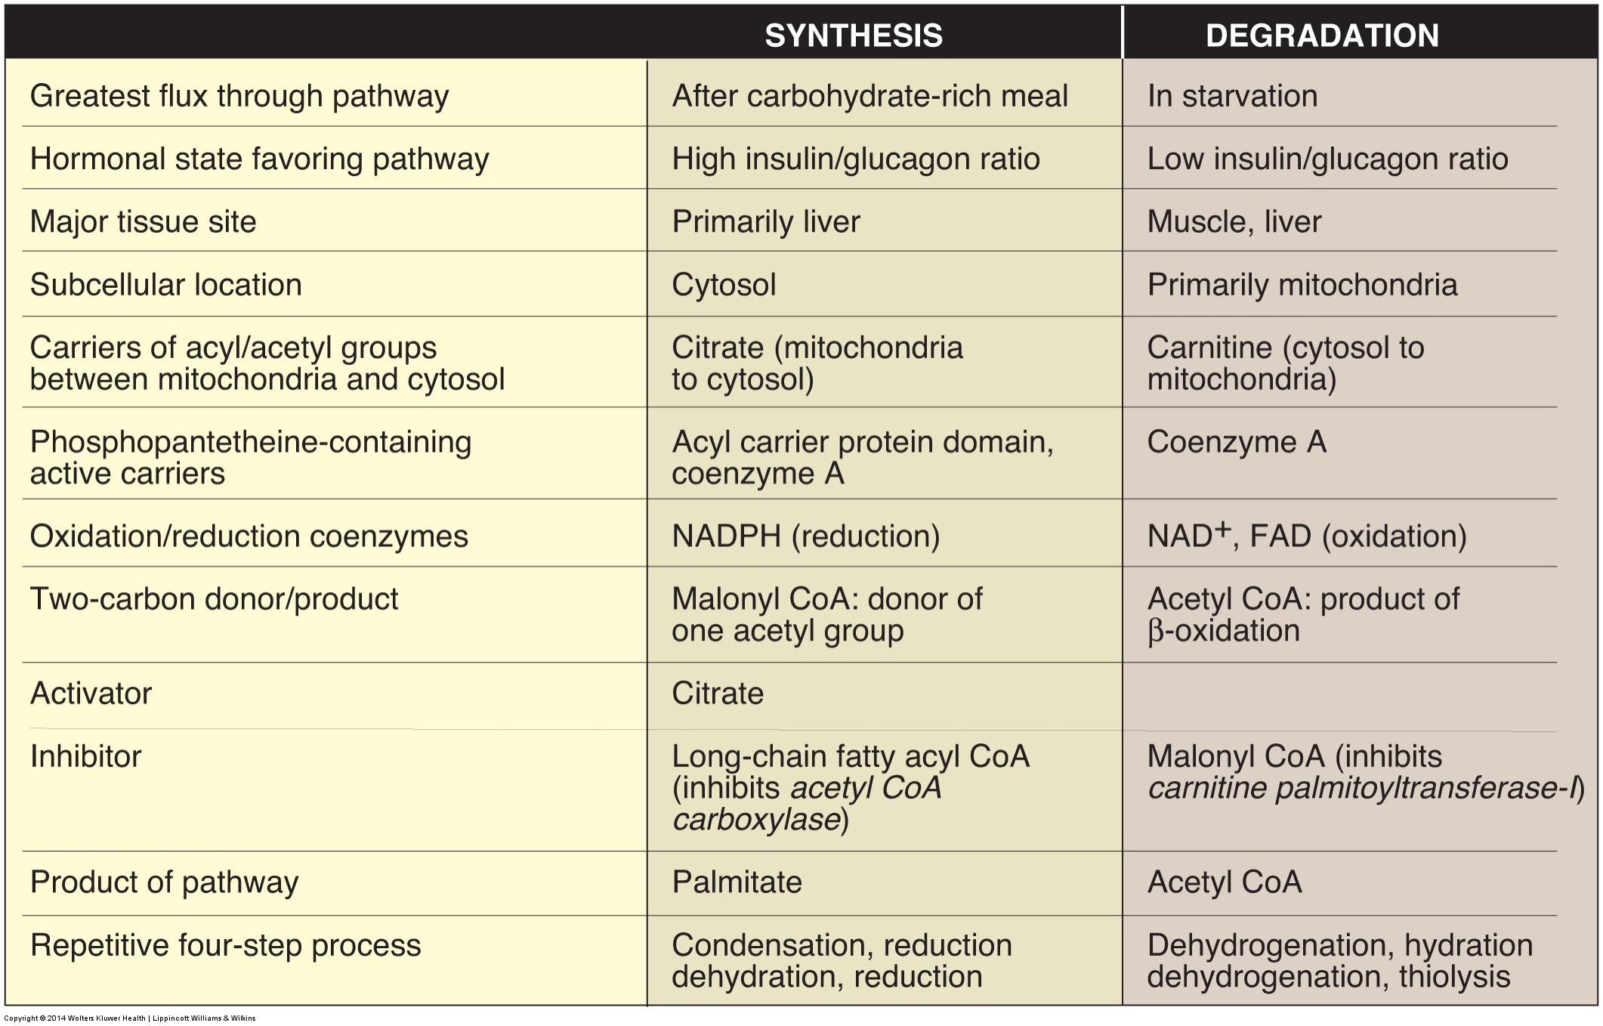
Summary of Fatty Acid Oxidation/Synthesis

Slide 38
Ketogenesis
What if there isn’t enough OAA to burn off all that acetyl-CoA?
Or there is so much NADH/FADH built up, TCA is blocked?

Slide 39
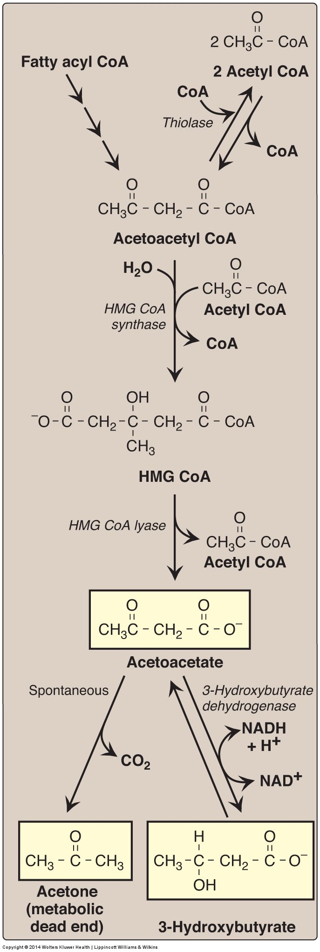
Ketogenesis Overview
Ketogenesis produces ketone bodies
Acetoacetate
Beta-hydroxybutyrate
Acetoacetate and B-hydroxybutyrate transported to tissues to be oxidized

Slide 40
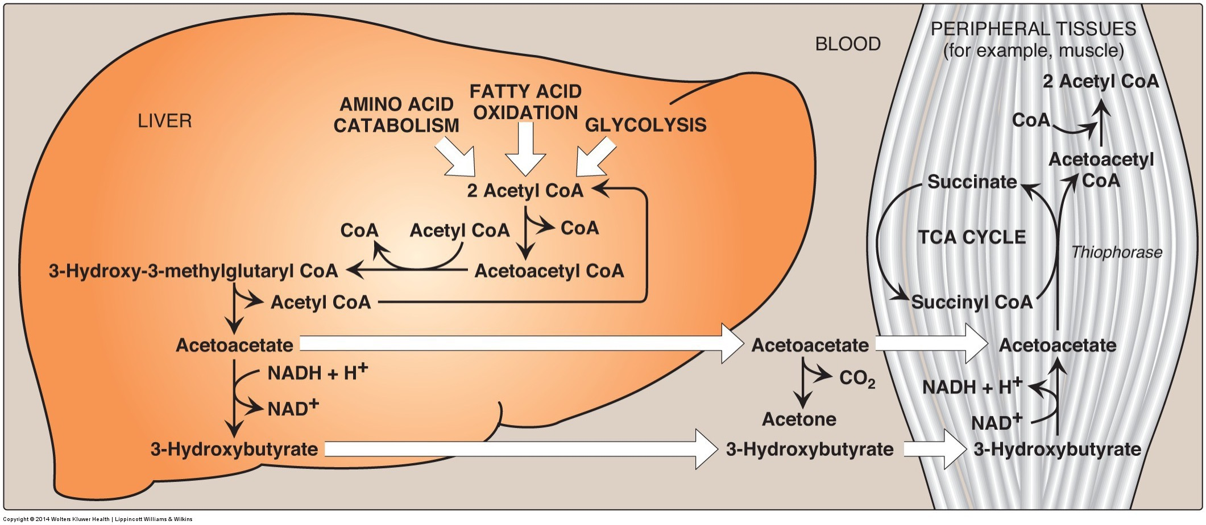
Ketone Bodies
Ketogenesis:
Mainly occurs in liver
Ketones do not stay in liver because it lacks enzyme for initial reaction of ketone body oxidation
Ketone body oxidation: ketone bodies → acetyl CoA
Brain, heart, muscle, etc.
Acetyl CoA enters Krebs

Slide 41
Diabetic Ketoacidosis
Causes
Consequences
Conditions in which build up could occur
Untreated type 1 and type 2 diabetes: Low levels of circulating insulin
Type 1 – beta cells cannot make insulin
Type 2 – beta cells are damaged from prolonged periods of overproduction of insulin
Cannot stop lipolysis
Accompanied by hyperglycemia
Coma,
Dehydration
excessive urination
vomiting
organ failure
About 140 000 hospitalizations per year in the USA (CDC, 2009)

Slide 42
Ketogenic Diets
Very low carbohydrate diets
Accompanied by normoglycemia
Why does dietary ketosis not lead to as high of ketone body levels?
DKA: beta hydroxybutyrate >15 mM
Nutritional Ketosis: beta hydroxybutyrate <3 mM
Notes:
Think in the muscle, what is controlling the levels of OAA

Slide 43
Learning Objectives
Understand how fatty acids are synthesized in the body
Describe the initial highly regulated step of FA synthesis
Understand the reactions resulting in triacylglycerol synthesis resulting in 3 fatty acids esterified to glycerol
Describe the breakdown of triacylglycerol to glycerol plus fatty acids and the fates of these products
Describe fatty acid breakdown (beta-oxidation)
Determine the amount of energy produced by fatty acid breakdown in comparison to glucose
Understand when ketogenesis occurs, what organs ketones are a fuel source for and consequences of overactive ketogenesis

Slide 44
Triglyceride Synthesis

Slide 45
Overview of Lipid Metabolism
Fatty Acid Metabolism
Obtaining Fatty Acids from Diet
Making Fatty Acids de novo
Oxidizing Fatty Acids
Triglyceride Metabolism
Synthesizing new triglycerides
Mobilizing Fatty Acids from Triglycerides
Cholesterol Metabolism
Cholesterol Synthesis
Cholesterol Excretion (Bile Salts)

Slide 46
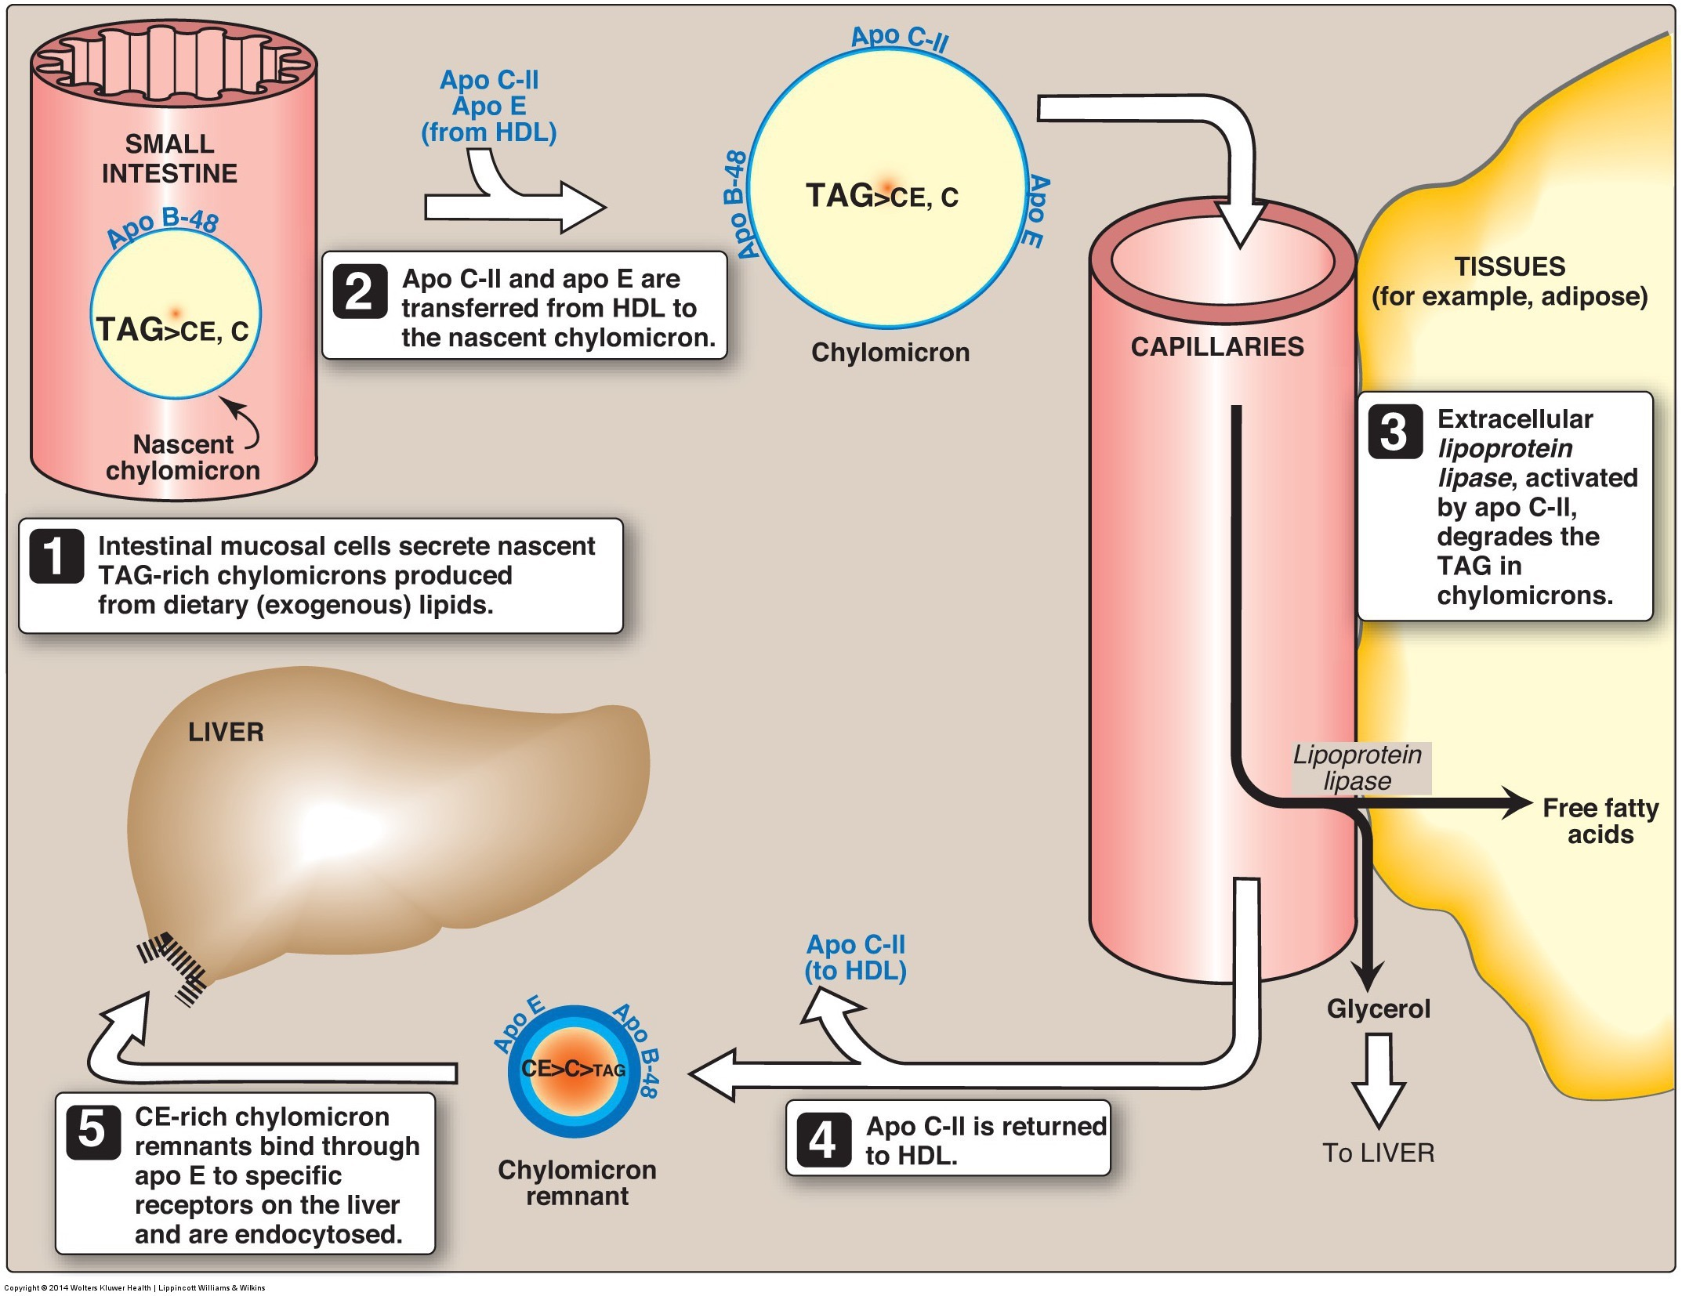
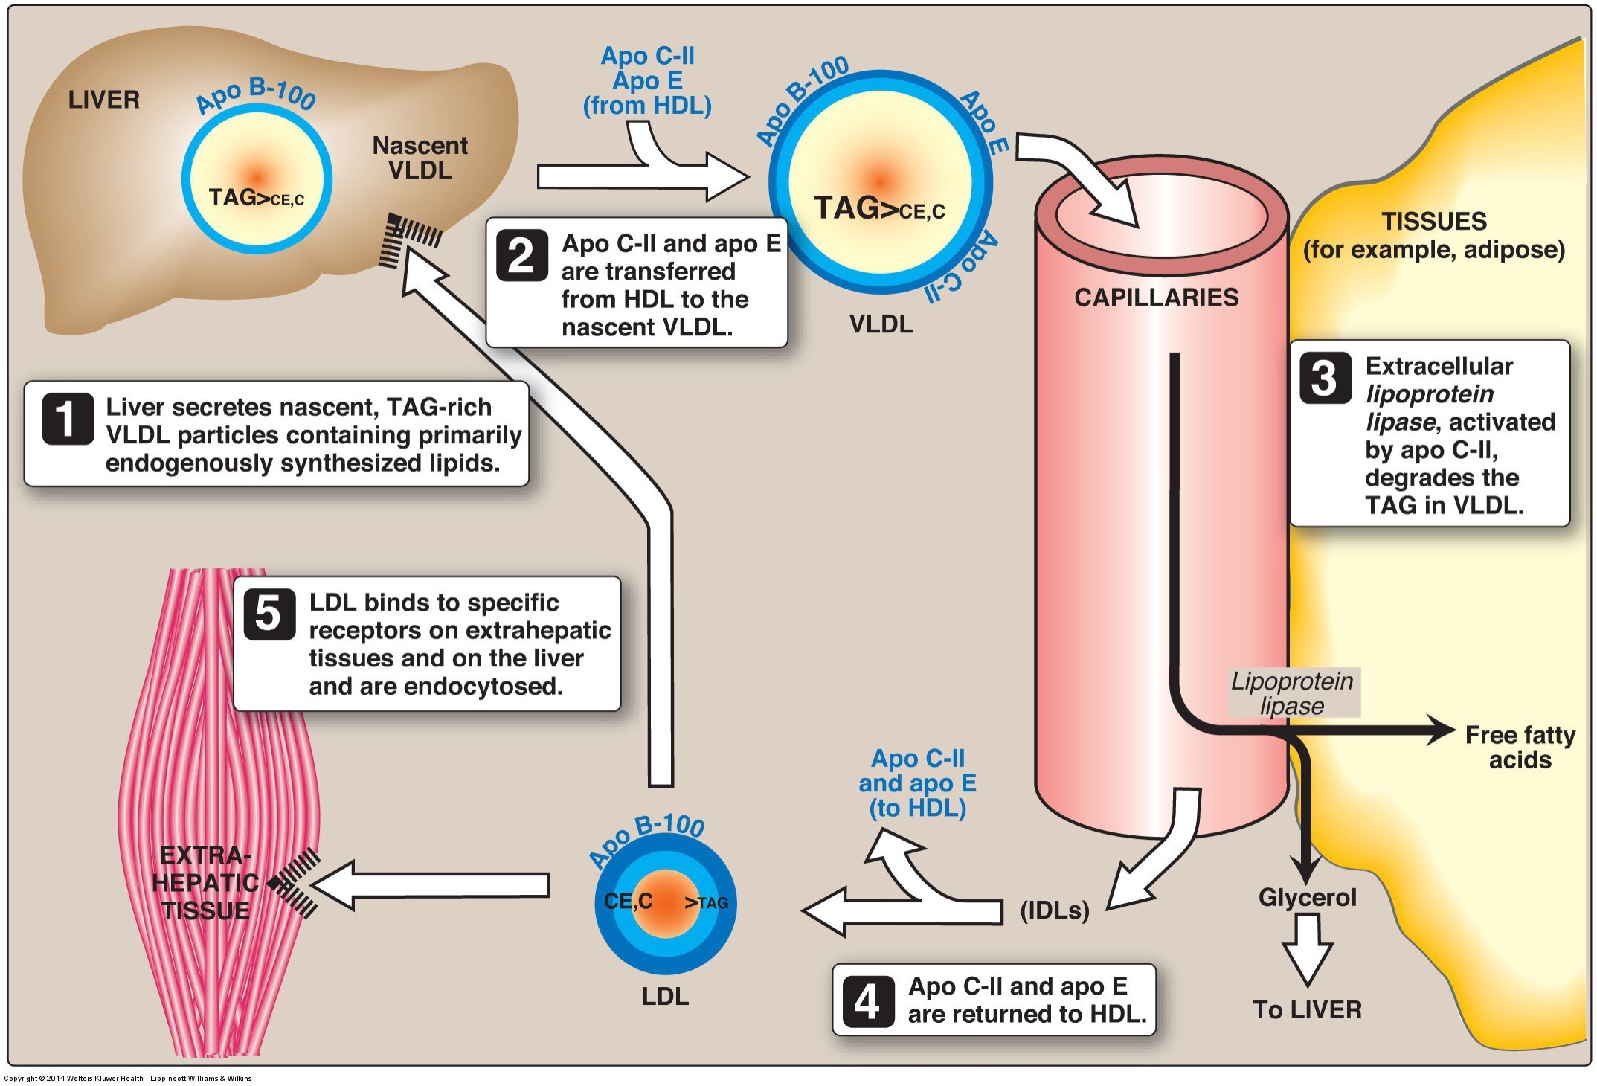
Triacylglycerol Synthesis
Mainly synthesized in liver and adipose tissue
Small amount from de novo lipogenesis
Primarily fatty acids from dietary fat
In the liver triglycerides are synthesized, then packaged for transport to adipose tissue via VLDL

Slide 47
Triacylglycerol Synthesis
Step 1: Two fatty acyl groups (FA-C-CoA) transferred to glycerol 3-P to form diacylglycerol 3-P
O
||
O
||
Acyl group = FA-C-CoA
Acyltransferases
Glycerol 3-phosphate
Phosphatidic acid
(diacylglycerol 3-phosphate)
2 Fatty acid acyl-CoA
2 CoA

Slide 48
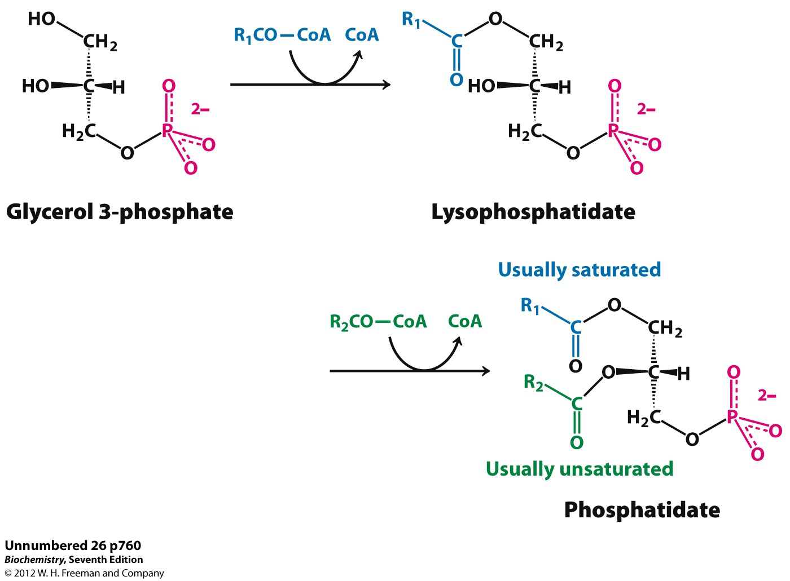
Step 1: Triacylglycerol Synthesis: 2 fatty acyl groups added
Fatty Acid
Step 1: Acyl groups (R-C=O) transferred to glycerol 3-P to form a diacylglycerol
Ester Bond
Hydroxyl group of glycerol reacts with fatty acyl group
Phosphatidic acid
(diacylglycerol 3-P)

Slide 49
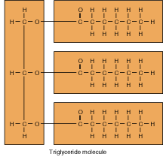
Phosphatidic acid
(diacylglycerol 3-P)
Triacylglycerol

Slide 50
Triacylglycerol Synthesis
Step 2: Dephosphorylation of diacylglycerol 3-P and final fatty acid acyl transfer
Acyltransferase and phosphatase
Phosphatidic acid
(diacylglycerol 3-P)
Triacylglycerol
Fatty acyl-CoA
CoA
P

Slide 51
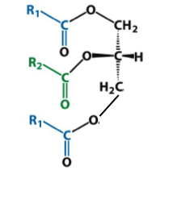
Step 2: Triacylglycerol Synthesis: Dephosphorylation and a fatty acyl groups added
3
Phosphatidic acid
(diacylglycerol 3-phosphate)
3
P
Triacylglycerol

Slide 52
3
Triacylglycerol
Triacylglycerol

Slide 53
Triacylglycerol Fate
Major destination is adipose tissue for storage
Incorporated into VLDL in liver
Exported from liver through circulation via VLDL

Slide 54
Integrated Control of Lipid Metabolism

Slide 55
Summary
Fatty Acid Synthesis
Triacylglycerol Synthesis
Initial reaction: acetyl CoA converted to malynol CoAs
Highly regulated
7 Malynol CoA transfers 2 carbons to Acetyl CoA
Palmitate is final product (16-carbon FA)
Palmitate can be further elongated or desaturated
Two fatty acyl CoAs transfer acyl group to glycerol 3-phosphate
Resulting diacylglycerol 3-P is dephosphorylated and fatty acyl donates final acyl
Triacylglycerol is formed
Triacylglycerol is likely stored in adipose tissue until needed

Slide 56
Lipids: Cholesterol, Lipoproteins, and PUFAs
1) Structure and Properties 2)Digestion, Absorption, and Transportation 3) Metabolism

Slide 57
Learning Objectives
Identify the functions of cholesterol within our body
Understand that cholesterol homeostasis is highly regulated in the body
Describe the 3 main steps of cholesterol synthesis
Describe the main carriers of cholesterol throughout the body
Understand the etiology of “high” cholesterol and its potential role in atherosclerosis
Understand why some unsaturated fatty acids are essential
Describe the different functions of omega-3 and -6 derivatives
Identify the sources of omega-3 and -6 and their derivatives

Slide 58
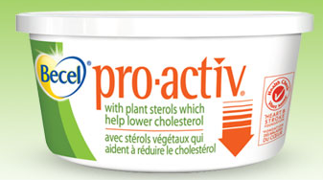
Cholesterol
Sterol family
Plant sterols
Cholesterol – animal products
Plant sterols interfere with cholesterol absorption

Slide 59
Cholesterol
Dietary intake plus biosynthesis of cholesterol is about 1 g/day
US intake estimated around 300-600 mg/day (0.3g/day)
Biosynthesis accounts for up to 60-70% of total daily cholesterol
Highly regulated
Mainly in liver, but can occur in all nucleated cells

Slide 60
Functions of Cholesterol
Cell membranes – >90% of cholesterol found in cell membranes
Steroid hormones – estrogen, progesterone, testosterone, glucocorticoids, androgens, mineralocorticoids (aldosterone)
Vitamin D – synthesis in the skin from ultraviolet rays
Bile – aides in lipid and fat-soluble vitamin absorption

Slide 61
Cholesterol Biosynthesis
At least 26 steps of cholesterol synthesis
3 stages:
3 Acetyl CoA → → 3-hydroxy-3methylglutaryl CoA (HMG CoA)
HMG CoA → mevalonic acid →→ Squalene
Squalene → →Cholesterol
HMG CoA Reductase

Slide 62
Cholesterol Biosynthesis
3 Acetyl CoA →→ 3-hydroxy 3-methylglutaryl CoA (HMG CoA)
- Condensation of 3 acetyl CoA
HMG CoA → mevalonic acid →→ Squalene
- HMG CoA reductase is rate limiting step
- As mevalonic acid increases, it inhibits HMG CoA reductase
HMG CoA Reductase

Slide 63
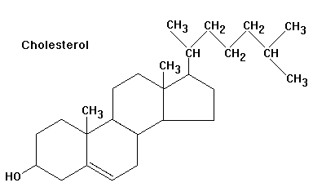
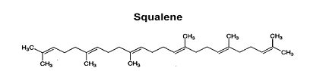
Cholesterol Biosynthesis
Squalene →→ Cholesterol
Squalene goes through series of cyclization reactions – to produce 4 ring core (steroid nucleus)
As intracellular cholesterol increases, it inhibits HMG CoA reductase
→→

Slide 64
Cholesterol Biosynthesis Regulation
Negative feedback system of mevalonic acid and endogenous cholesterol on HMG CoA reductase
Dietary intake of cholesterol suppresses production only in liver
Cholesterol

Slide 65
Lipoprotein
Lipoprotein – transport vehicle for lipids
Important in transportation of dietary and endogenous cholesterol
Four main types- distinguished by size and density
Chylomicrons – dietary cholesterol
Very low density lipoprotein (VLDL)
Low density lipoprotein (LDL)
High density lipoprotein (HDL)

Slide 66
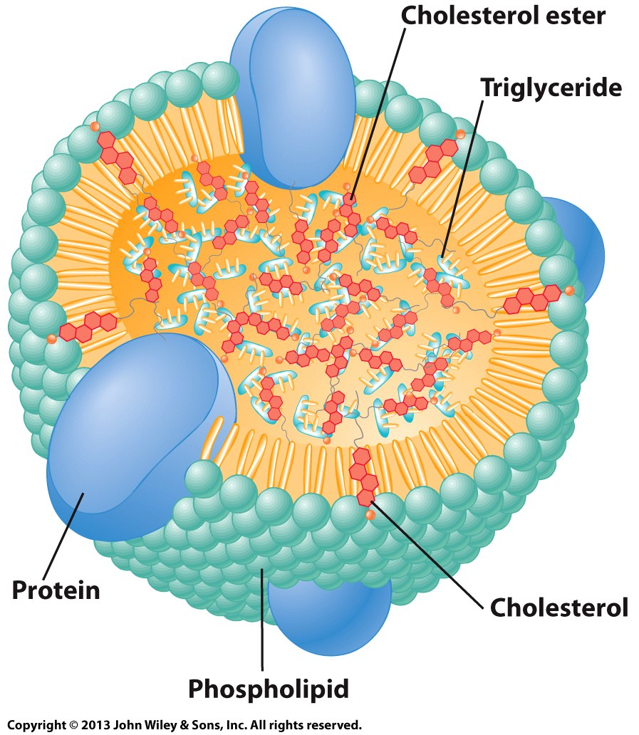
Lipoproteins
Apolipoprotein
General Structure of Lipoproteins:
Hydrophobic lipids in core
Surrounded by phospholipids and apolipoproteins
Apolipoprotein
Apolipoprotein
Apolipoprotein

Slide 67
Lipoprotein
Chylomicron: transporter of dietary cholesterol and other lipids (e.g., triacylglycerols) from enterocyte
Lowest density of 4 lipoproteins
Richest in triacylglycerol
Re-esterfied lipids (from diet) packaged into core of chylomicrons
First destination muscle and adipose tissue

Slide 68
Lipoprotein
At muscle and adipose tissue
Lipoprotein lipase (LPL) activated by ApoC
LPL hydrolyzes fatty acids from triacylglycerol
Fatty acids enter tissues
Product of LPL is called a chylomicron remnant: Cholesterol rich
Chylomicron remnant travels to liver

Slide 69
Lipoprotein Metabolism
Chylomicron remnant rich of cholesterol esters enters liver
Cholesterol esters plus endogenous cholesterol and triacylglycerol reincorporate into VLDL
VLDL - Cholesterol esters and cholesterol (and some endogenous triacylglycerol)
Transporter out of liver
Contains apoB-100, apoC, and apoE

Slide 70
FA
FA
Adipose Tissue
Muscle
FA
FA
FA
FA
FA
FA
Small Intestine
LPL
LPL
Chylomicron Remnant (cholesterol rich)
Chylomicron
Chylomicron
Liver
VLDL (cholesterol and endogenous triacylglycerol)

Slide 71
Lipoprotein Metabolism
VLDL travels to adipose tissue and muscle
Lipoprotein lipase (LPL) activated by ApoC
LPL hydrolyzes triacylglycerol resulting in IDL
Travels to liver OR continues to decrease in triacylglycerol to become LDL
VLDL → IDL → LDL

Slide 72
Low-Density Lipoprotein (LDL)
LDL is major carrier of cholesterol through circulation
LDL transports to various tissues
Still contains apoB-100, apoC, and apoE
LDL receptors (LDLR) of tissue respond to apoB-100 and apoE
LDLRs found in majority of tissues

Slide 73
FA
FA
Muscle
FA
Adipose Tissue
FA
FA
FA
FA
FA
FA
Small Intestine
LPL
LPL
Chylomicron Remnant (cholesterol rich)
Chylomicron
Chylomicron
Tissue
Tissue
LDLR
LDLR
Tissue
LDLR
Liver
VLDL (cholesterol and endogenous triacylglycerol)
LDL (cholesterol rich)
IDL (cholesterol rich, very little triacylglycerol)
VLDL (cholesterol and endogenous triacylglycerol)
LDLR

Slide 74
Low-Density Lipoprotein (LDL)
LDLR – 5 domains
Example of domains functions:
Domain 1: cysteine rich domain – negatively charged to bind positively charged apoB-100 and apoE
Domain 3: rich in hydrophobic amino acids– high affinity for lipids

Slide 75
Low-Density Lipoprotein (LDL)
Number of LDLRs synthesized varies according to cholesterol levels
LDL binds to LDLR
Internalized by endocytosis
LDL enters into lysosome of cell
LDL hydrolyzed to AAs, FFAs, and free cholesterol
Free intracellular cholesterol modulates activity of:
HMG CoA reductase – suppression
Enzyme involved in cholesterol synthesis

Slide 76
LDLR Mutations
Cells unable to bind LDL via LDLRs (mutant cells)
Mutant cells – defect of chromosome 19
110 mutations effecting differing domains of LDLR
Broad term called Familial Hypercholesterolemia
1 in 500 carry at least one mutation
Emily C. O’Brien, PhD, et al.Rationale and design of the familial hypercholesterolemia foundation CAscade SCreening for Awareness and DEtection of Familial Hypercholesterolemia registry. American Heart Journal. 167:3. March 2014

Slide 77
LDLR Mutations
Physiological outcomes:
Altered synthesis of LDLRs results in abnormal levels and functioning of receptors at cell membrane
Accelerated biosynthesis of cholesterol – HMG CoA reductase remains activated
Results in high LDL levels in blood
Diet can be contributing factor to high serum LDL
Controlled by drugs, dietary restrictions, exercise
Statins - class of drugs inhibiting HMG CoA reductase

Slide 78
High Density Lipoprotein (HDL)
No system to breakdown cholesterol
HDL produced in liver
Transports cholesterol from non-hepatic tissue and circulation to the liver, gonadal, and adrenal tissues
Synthesis of cholesterol containing compounds and excretion via bile (feces)
Contains apoE and apoA-1

Slide 79
High Density Lipoprotein (HDL)
HDL functions:
Ability to bind to SR-B1 (apoA-1) receptor and LDLR on liver and non-liver tissue
HDL contains apoE and apoA-1
LDLR recognizes apoB-100 and apoE
Stimulates lecithin: cholesterol acyltransferase (LCAT)
Cholesterol ester molecule moves into the core of HDL

Slide 80
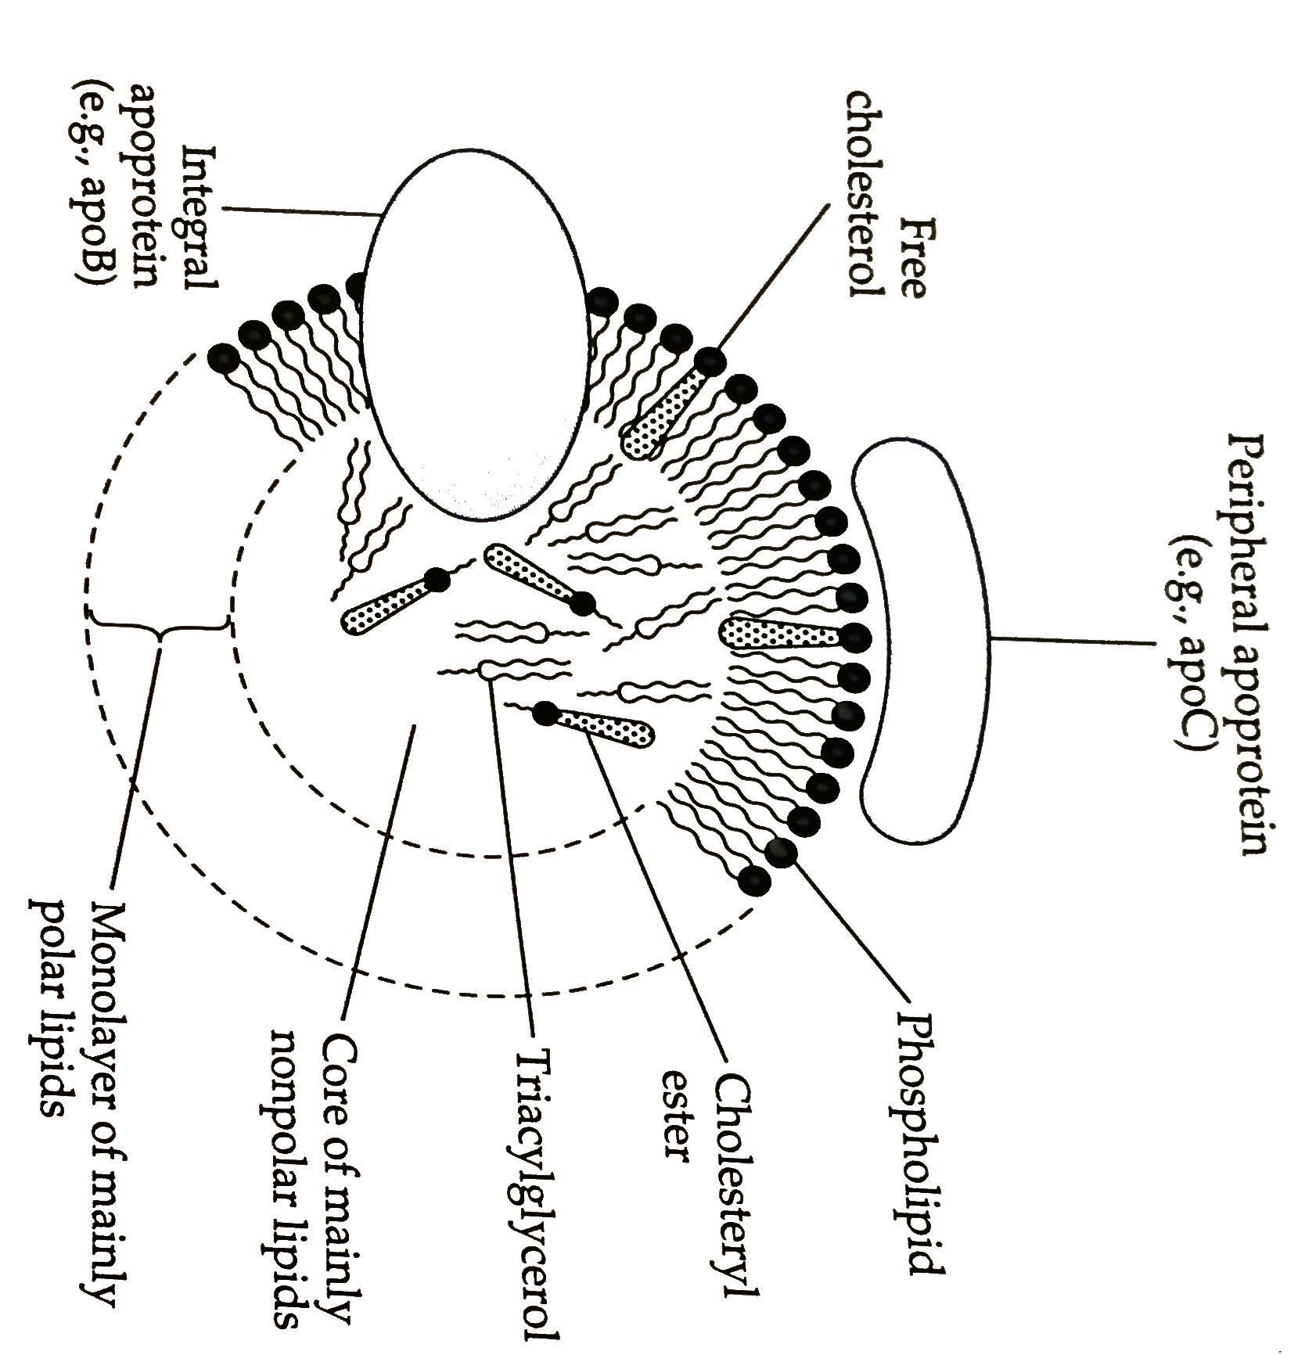
High-Density Lipoprotein (HDL)
HDL can remove cholesterol from LDL in circulation

Slide 81
FA
FA
Muscle
FA
Adipose Tissue
FA
FA
FA
FA
FA
FA
Small Intestine
LPL
LPL
Chylomicron Remnant (cholesterol rich)
Chylomicron
Chylomicron
Tissue
Tissue
Tissue
HDL
Liver
VLDL (cholesterol and endogenous triacylglycerol)
LDL (cholesterol rich)
IDL (cholesterol rich, very little triacylglycerol)
VLDL (cholesterol and endogenous triacylglycerol)

Slide 82
High-Density Lipoprotein (HDL)
Health benefits of removal of cholesterol from non-hepatic tissue and reducing circulating cholesterol by removing free cholesterol from LDL
- Transports cholesterol to other tissue
Liver: bile for excretion
Adrenal and gonadal: steroid hormones
High HDL levels associated with reduced risk of CVD

Slide 83
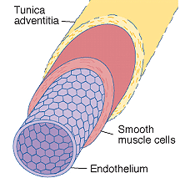
Lipid and Cardiovascular Disease Risk
Atherosclerosis – type of cardiovascular disease (CVD)
Degenerative disease of vascular endothelium – plaque build-up
Immune response from cell injury + lipid material
Vascular endothelium – space between blood flow and blood vessel

Slide 84
Lipid and CVD Risk – Atherosclerosis
Initiation of plaque buildup
Injury to lining of vessel wall – promotes macrophage production
LDL deposited into vessel wall
Cigarette smoking
Infections
LDL in circulation are oxidized and readily taken up by macrophage

Slide 85
Lipid and CVD Risk – Atherosclerosis
Macrophages contain scavenger receptors
Receptors can bind oxidized LDL and LDL
Macrophage internalizes LDL
Platelets, cellular debris, calcium too
Build-up of LDL inside of macrophage results in foam cell
Foam cell accumulate in blood vessel (plaque buildup)
Thickening of vessel wall
Results in occlusion of blood vessels

Slide 86
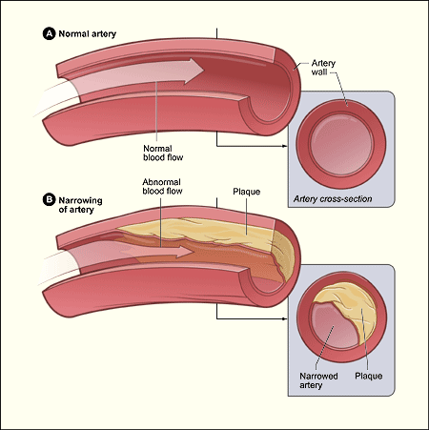
Lipid and Disease Risk – atherosclerosis

Slide 87
Lipid and Disease Risk – atherosclerosis
Plaque build-up in all vessels throughout body
Atherosclerosis leads to several disease types
Coronary heart disease
Kidney disease
Peripheral arterial disease
High blood pressure
Angina (chest pain)
Diabetes
Total occlusion of vessel or breakage of plaque
Results – heart attack, stroke, etc.
Ross, J. et al. Atherosclerosis and Cancer:Common Molecular Pathways of Disease Development and Progression. Annals of NY Academy of Sc. 2006

Slide 88
Cholesterol as Key Player in Atherosclerosis
Majority of lipid portion of plaque as LDL
Genetics – Familial hypercholesterolemia
Controlled by drugs and dietary restrictions
Distribution of cholesterol in HDL (good) and LDL (bad)
Higher HDL levels reduces cholesterol deposited in blood vessels by removing cholesterol from LDL
Exercise can increase HDL
Dietary changes to cholesterol - little impact on blood cholesterol
Synthesis of cholesterol is HIGHLY regulated – compensatory mechanisms kick in
McNamara, DJ. Dietary cholesterol and atherosclerosis. Biochim Biophys Acta. 2000 Dec 15;1529(1-3):310-20
Thompson PD. What do muscles have to do with lipoproteins? Circulation. 1990;81:1428–1430

Slide 89
Cholesterol – circulating levels
Normal circulating levels
LDL
<100 mg/dL– optimal
100 -129 mg/dL– suboptimal
HDL
Men: >40 mg/dL
Women: >50 mg/dL
Total Cholesterol
<200 mg/dL

Slide 90
Activity
Draw out pathway of:
chylomicron → VLDL→LDL
Include:
apolipoproteins involved and functions
Specific lipids it transports
Destination

Slide 91
Polyunsaturated Fatty Acids
Omega-6 (linoleic acid)
Omega-3 (alpha-linolenic acid)

Slide 92
Polyunsaturated Fatty Acids (PUFA)
PUFA - Essential fatty acids
Omega-6 (linoleic acid)
Omega-3 (alpha-linolenic acid)
Plants
Sources of omega-6 and -3 fatty acids
Marine animals
Fish – eat marine plants (contain omega-3)
Source of omega-3 derivatives – EPA and DHA
Poultry and Beef – grain fed (contain omega-6)
Source omega-6 derivatives

Slide 93
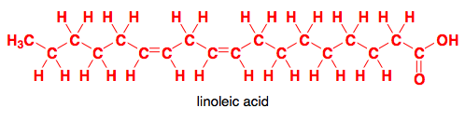
PUFA Metabolism
Omega-3 and -6 are 18 carbon FAs
Humans lack delta12 and delta15 desaturases
Cannot incorporate double bonds at omega-3 and -6 positions
Omega-6 → arachidonic acid → eicosanoids
(Omega-6)
Omega-3→ EPA → DHA
Eicosanoids

Slide 94
Polyunsaturated Fatty Acids (PUFA)
Omega-6 → arachidonic acid → eicosanoids
Omega-6
Most abundant in dietary sources
Sources:
Sunflower, Safflower, Corn, Sesame, soybean oils
Grains
Beef and poultry
Precursor of arachidonic acid (AA)
AA is precursor for eicosanoids
Role in: Blood clotting (increases) and Pro-Inflammatory response
Arachidonic acid role in:
Brain development
Adequate intake:
Women: 12 g/day
Men: 17 g/day
Average intake about 20-25 g/day

Slide 95
Polyunsaturated Fatty Acids (PUFA)
Omega-3→ EPA → DHA
Eicosanoids
Omega-3
Sources:
Marine vegetation – food source for fish
Soybean, flaxseed, canola oils
Precursor of EPA and DHA
EPA is precursor for eicosanoids
Eicosanoids role in: Blood clotting (decreases) and Anti-inflammatory response
EPA and DHA role in:
Neural and visual development and maintenance
Adequate intake:
Women: 1.1 g/day
Men: 1.6 g/day

Slide 96
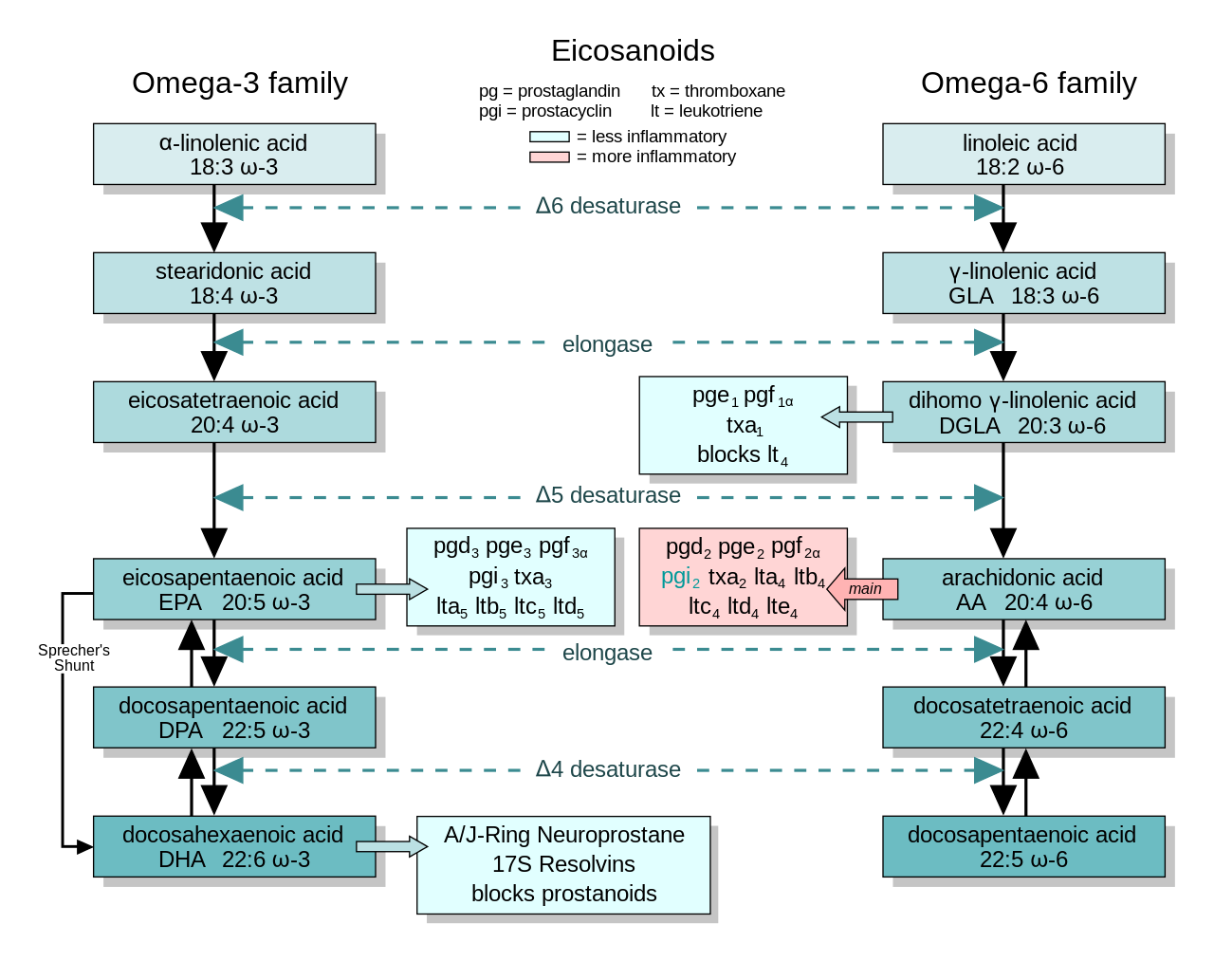

Slide 97
Polyunsaturated Fatty Acids (PUFA)
Eicosanoids: counteracting roles in body – ratio of Omega-6:Omega-3 FAs are highly studied
5:1 to 10:1
Example: 20 g of omega-6 with 2-4 g of omega-3
Typical suggestion: Decreased ratio = decreased disease risk
Omega-6 is abundant in westernized diet
High intake associated with adverse physiological outcomes
More prone to oxidation within body
Chronic inflammation – cancer, obesity, CVD, etc.
SM Grundy. AJCN. 1997; http://www.hsph.harvard.edu/nutritionsource/

Slide 98
Polyunsaturated Fatty Acids (PUFA)
Omega-3 conversion to EPA and DHA is inefficient
Competing for enzymes that metabolize omega-6
Highly recommended to take in sources of EPA and DHA (aka fish oils)
Livestock feed can be manipulated to increase or decrease these ratios
For example – exposure to different oils
SM Grundy. AJCN. 1997; http://www.hsph.harvard.edu/nutritionsource/

Slide 99
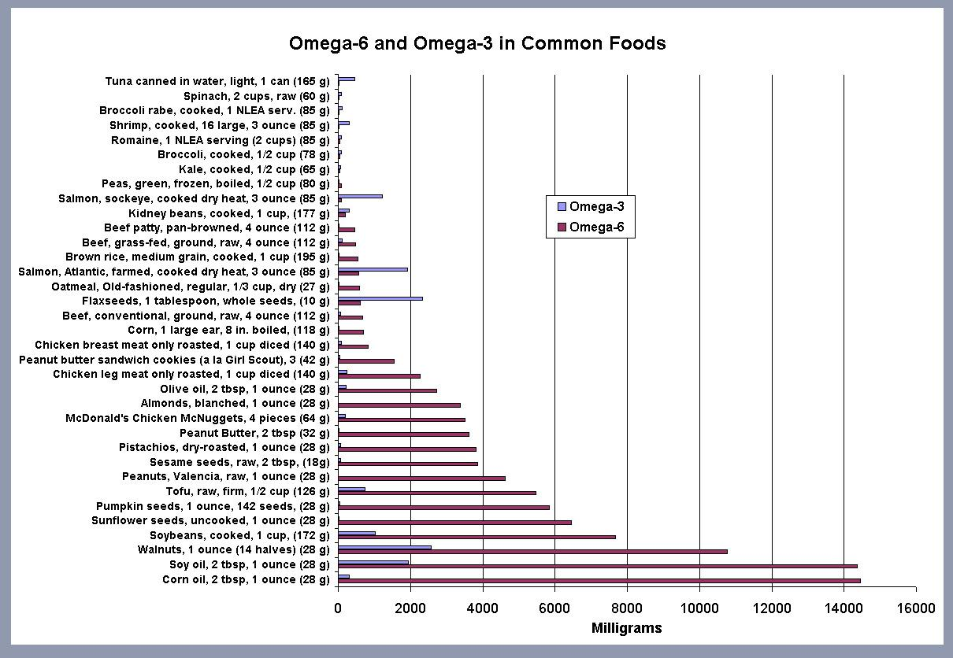
Polyunsaturated Fatty Acids (PUFA)

Slide 100
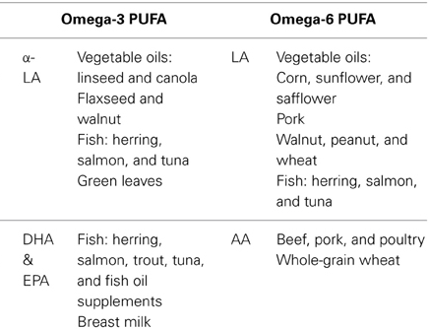

Slide 101
Summary
Cholesterol homeostasis is highly regulated on a daily basis
3 main steps to cholesterol synthesis
HMG CoA reductase is a highly regulated enzyme of cholesterol synthesis
LDL is main carrier of endogenous cholesterol through our bodies
LDLRs of many tissue types uptake LDL
Mutations of LDLR is highly prevalent and can result in high levels of circulating cholesterol
HDL rids free cholesterol from build-up
Cholesterol used to build other compounds
Omega-3 and -6 are essential fatty acids
Their derivatives have very important physiological roles in the body
Have counteracting roles in the body
Ratio of intake has implications health

